Slide 1
Unit 3
Chapter 5
Lesson 1
Day 2
Pages 126-132; 145-146

Slide 2

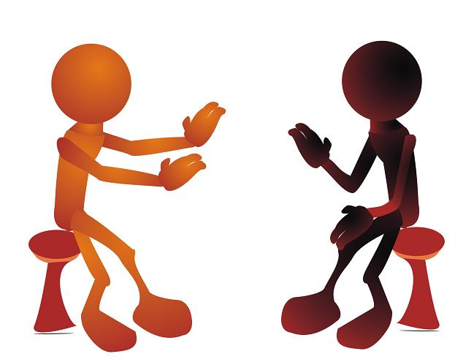
Visual Literacy
Look at the picture on pgs. 118-119 and write three questions about the picture.
Share your questions with a partner.

Slide 3
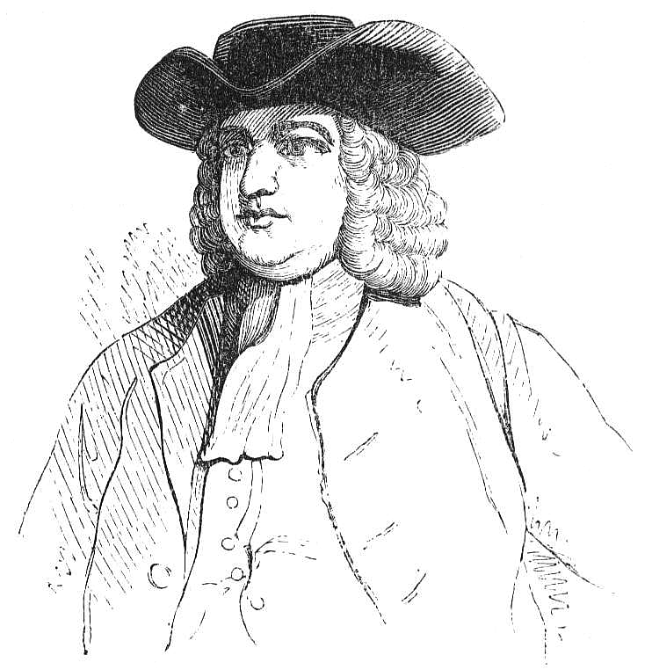
In 1681, Penn’s cousin, William Markham, led the first group of English colonists to Pennsylvania.

Slide 4
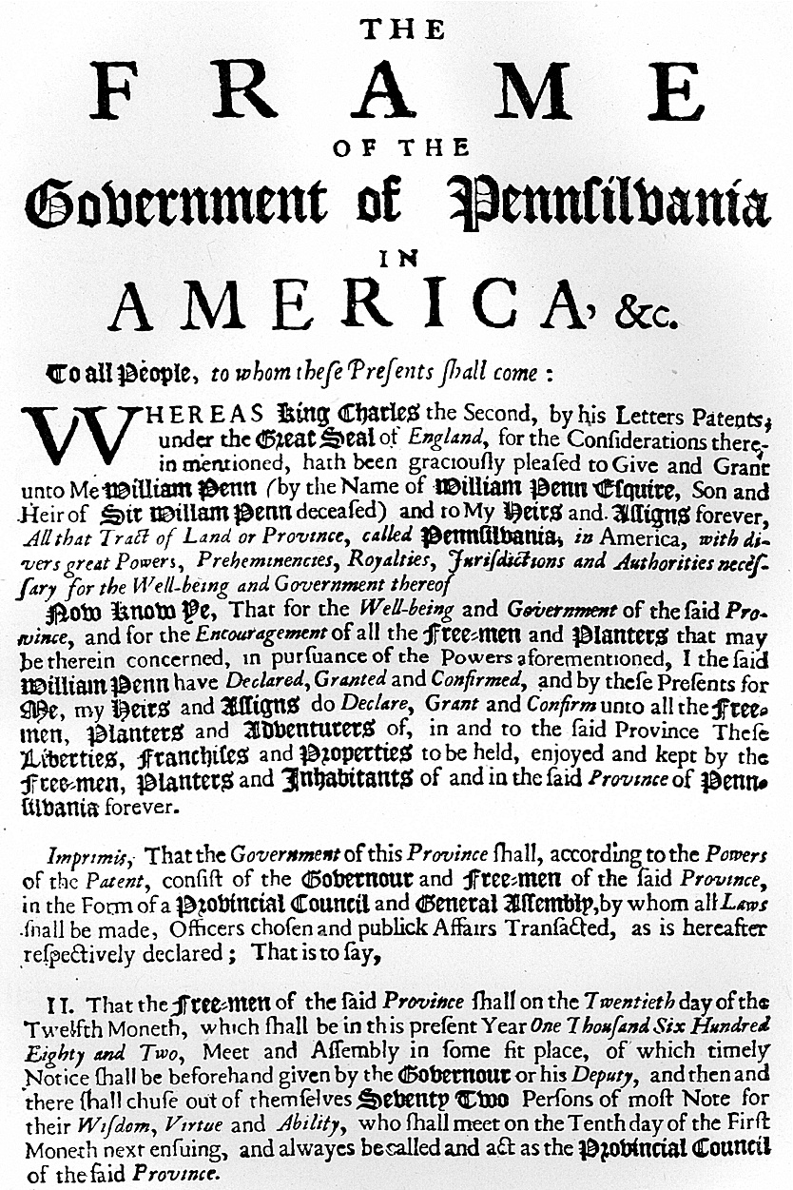
In 1682, Penn wrote Pennsylvania’s first constitution called the First Frame of Government. It made sure that everyone had freedom of religion.

Slide 5
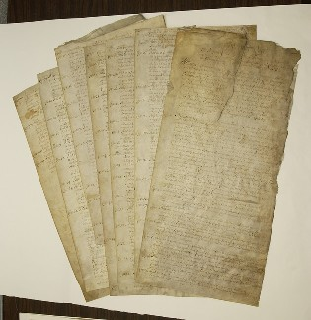
Penn also created the Great Law, which made sure that the people of Pennsylvania had a voice in their government.

Slide 6
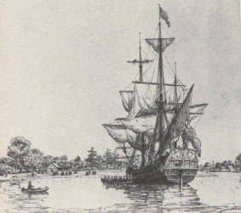
William Penn came to Pennsylvania for the first time in 1682. He sailed on the ship Welcome. About 1/3 of
the people aboard the ship died
from smallpox on the journey.

Slide 7
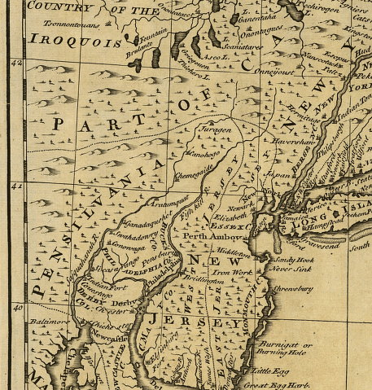
Penn divided his colony up into three counties: Bucks, Chester, and Philadelphia counties.

Slide 8
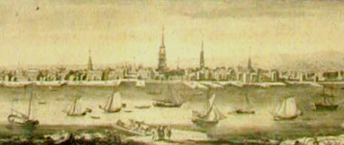
Penn also began planning the city of Philadelphia, which means “City of Brotherly Love.”

Slide 9
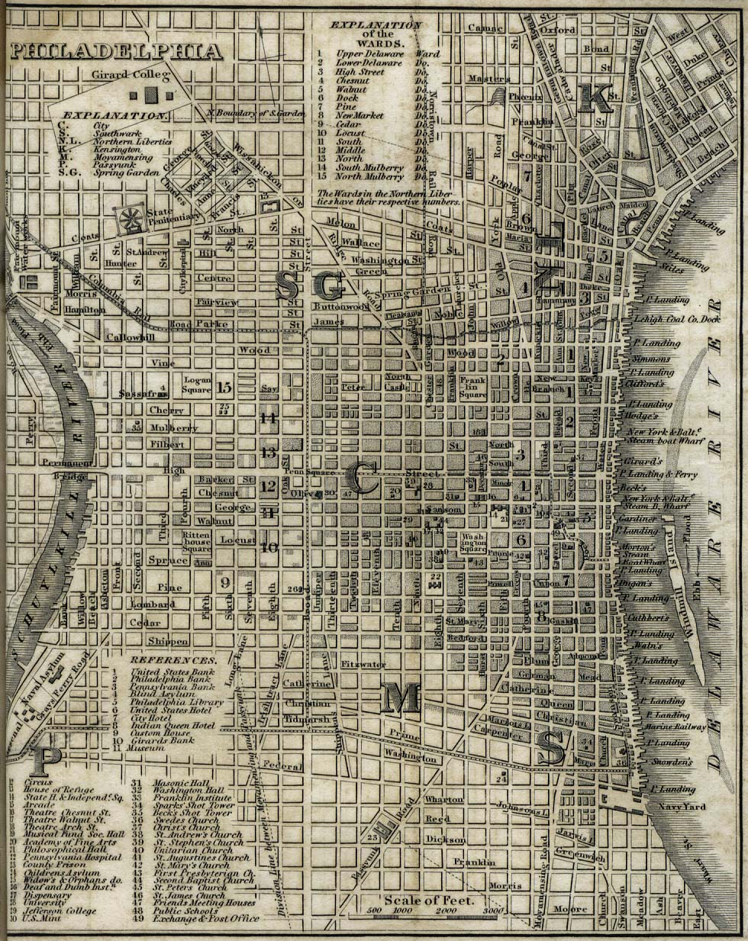
He designed Philadelphia to have straight streets, parks and public squares.

Slide 10
Quote and Comment
*Read the quote in the yellow box on pg. 131.
*This is something William Penn said to the Lenape Indians. Please write three lines describing what you think Penn meant when he said this.
*Share your answer with a partner.

Slide 11
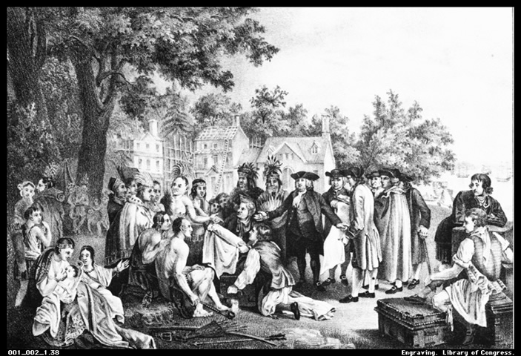
Penn treated the Native Americans living in Pennsylvania fairly. He wanted to be friends with them, and they respected him for that.

Slide 12
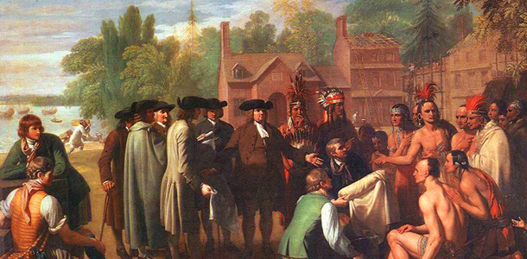
Penn and the Lenape signed the Treaty of Shackamaxon, in which Penn bought the land given to him by the king.

Slide 13
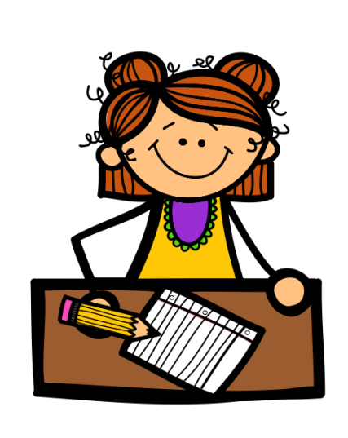

3-2-1
3- Write three facts you learned from today’s lesson.
2- Write two questions you have about what you learned today.
1- Write one thing you found interesting today.

